Slide 1
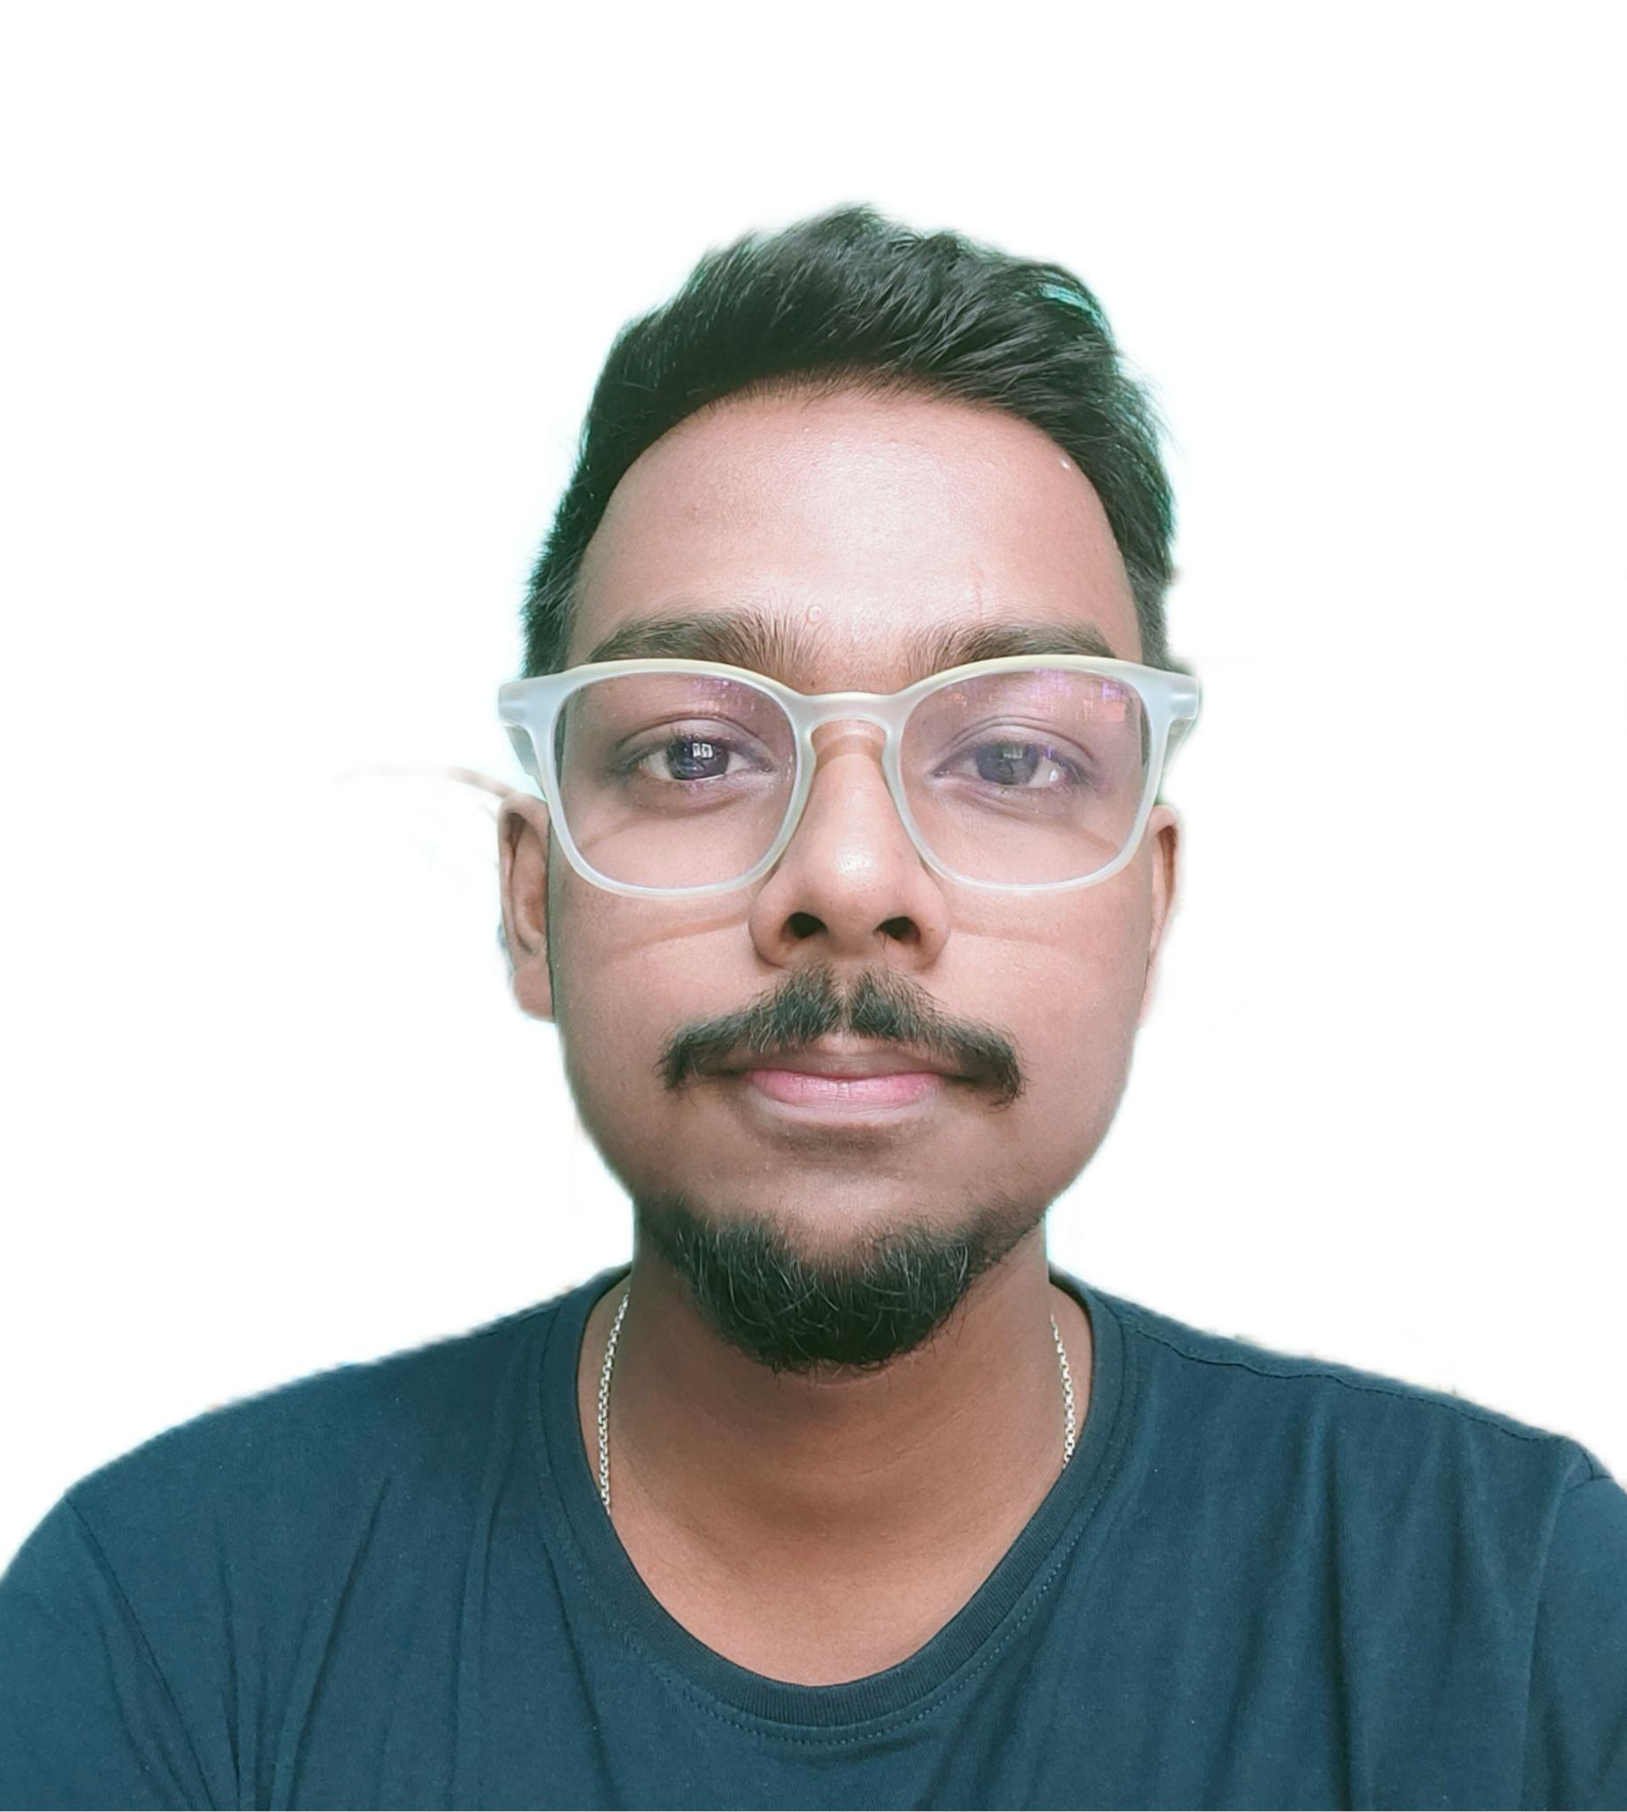


Duttatreyo Bagchi
Bachelor of Technology, ECE : 2018-2022
Analyst
iTransform L&D Leftshift Batch
Skills
C# | Basics, OOPS, Exception Handling ,Arrays ,Collection Generics and Loops
.NET Framework | ADO.NET,ASP.NET with MVC and WEB API, Entity Framework
Database | Microsoft SQL Server Management Studio
Tools | GIT, Postman, Swagger
UI Technology | HTML5 ,CSS & Angular
Add On Skills | Communication Skills, Team Management, Microsoft Office
Mumbai
duttatreyo.bagchi@capgemini.com
+91 8336837505
A4
Full Stack Developer
Understanding of RDMS concepts using SQL Server.
Practical understanding of C# and SQL concepts using Visual Studio and SQL Server
Hands on experience in developing single page applications in Angular using HTML5, CSS3, TypeScript
Understanding of HTML5 , CSS and Angular Cli
Experience in creating documentation with Swagger and Postman
Completed case study on Hotel Management System which is a Web based System which is to automate various hotel management operations such as room reservations, room assignments, guests check-ins, guest check-outs and other activities concerned with hospitality operations. An all-in-one hotel management system is designed to better the performance of any hotel business from managerial and operational standpoint.
Technologies used:
Angular 10
ASP .Net Core Web API
Microsoft SQL Server
Video Link : Click
GitHub

